Slide 1
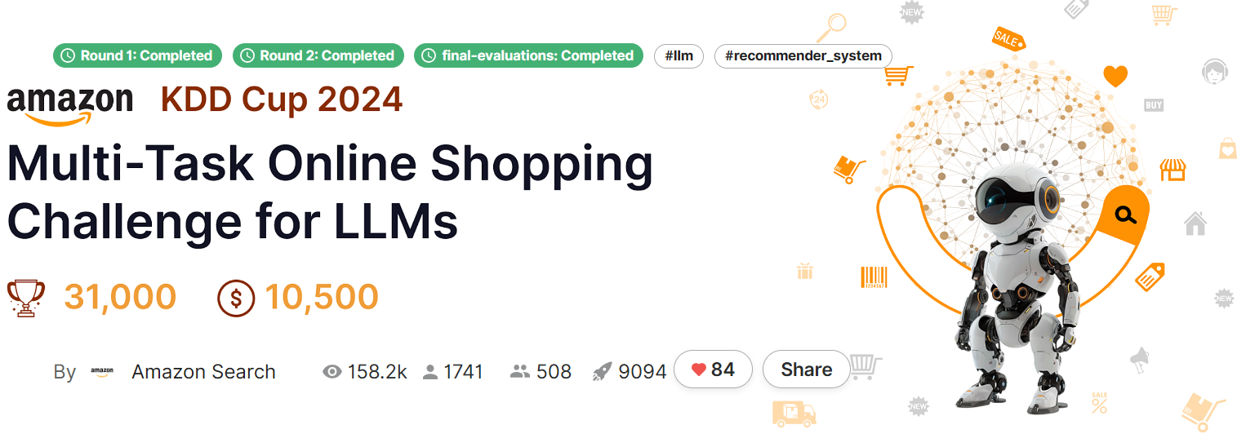
Online Shopping Challenge for LLMs
Goal: to build a useful assistant, answering questions in the domain of online shopping

Slide 2
Tasks
1.Shopping Concept Understanding
This skill emphasizes the ability of LLMs to understand and answer questions related to these concepts.
2.Shopping Knowledge Reasoning
Evaluating the model's reasoning ability on products or product attributes with domain-specific implicit knowledge.
3.User Behavior Alignment
User behavior modeling is of paramount importance in online shopping. However, user behaviors are highly diverse, including browsing, purchasing, query-then-clicking, etc. Moreover, most of them are implicit and not expressed in texts. Therefore, aligning with heterogeneous and implicit shopping behaviors is a unique challenge for language models in online shopping, which is the primary aim of this track.
4.Multi-lingual Abilities
Multi-lingual models are especially desired in online shopping as they can be deployed in multiple marketplaces without re-training. Therefore, we include a separate multi-lingual track, including multi-lingual concept understanding and user behavior alignment, to evaluate how a single model performs in different shopping locales without re-training.

Slide 3
Leaderboard Solutions
1th: Introduce a custom dataset (Eshop Instruct) and fine-tune LLMs with LoRA and GPTQ quantization, emphasizing prompt engineering.
2th(choose): Focus on a no-fine-tuning approach using base model selection, quantization, and prompt design.
3th: Use fine-tuning with a custom dataset, ensemble LoRA adapters, wise-ft, and quantization to achieve top performance across all tracks.
We choose prompt engineering because it’s more efficient for handling the multi-task nature of the problem. Fine-tuning would be resource-intensive, while prompt engineering allows us to leverage pre-trained models without the need for extensive retraining, making it a faster and scalable solution.

Slide 4
Dataset Description(Amazon)
ShopBench used in this challenge is an anonymized, multi-task dataset sampled from real-world Amazon shopping data. Statistics of ShopBench is given in the following Table.
The development datasets will be given in json format with the following fields.
input_field: This field contains the instructions and the question that should be answered by the model.
output_field: This field contains the ground truth answer to the question.
task_type: This field demonstrates the task type for the sample, e.g., “Retrieval”.
task_name: This field contains the name of the task. (e.g. task1, task2).
metric: This field specifies the metric of this sample.
track: This field specifies the track the question comes from, e.g., “Shopping Concept Understanding”.
# Tasks | # Questions | # Products | # Product Category | # Attributes | # Reviews | # Queries
57 | 20598 | ~13300 | 400 | 1032 | ~11200 | ~4500

Slide 5
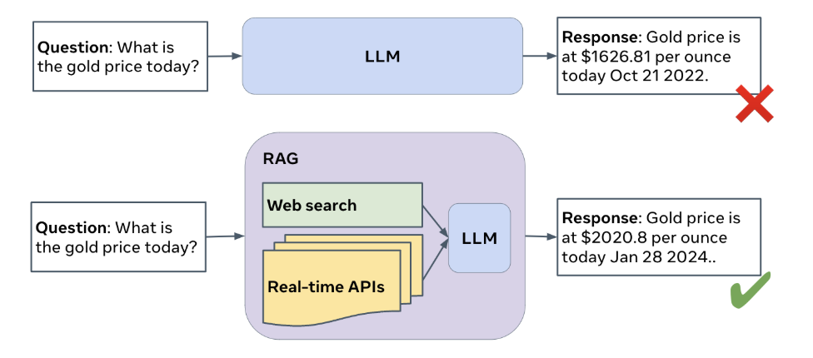
Comprehensive RAG Benchmark
A RAG QA system takes a question Q as input and outputs an answer A;
The answer should provide useful information to answer the question, without adding any hallucination or harmful content such as profanity.

Slide 6
Dataset Description(Meta)
The CRAG dataset is designed to support the development and evaluation of Retrieval-Augmented Generation (RAG) models. It consists of two main types of data:
Question Answering Pairs: Pairs of questions and their corresponding answers.
Retrieval Contents: Contents for information retrieval to support answer generation.
1. QA Pairs
Scope：4,409 question-answer pairs across 5 domains (finance, sports, music, movies, open-domain) and 8 question types.
Splits: Validation (30%), public test (30%), private test (40%). 2,706 examples (validation + public test) released.
Key Features: Covers popular to long-tail entities (e.g., "Elon Musk" vs. niche topics). Answers are time-sensitive (e.g., "Who is the UK Prime Minister?"), with a "query time" field for temporal context.
2. Retrieval Content ：Simulates real-world data sources for RAG training:
Web Search: Up to 50 real-world HTML pages per question (title, URL, snippet, timestamp). 5 pages randomly selected for tasks to mimic noisy search results.
Mock Knowledge Graphs (KGs): Contains 2.6 million entities (structured data). Accessed via Mock APIs (domain-specific parameters → JSON output, may include irrelevant/noisy data).
Field Name | Type
interaction_id | string
query_time | string
domain | string
question_type | string
static_or_dynamic | string
query | string
answer | string
alt_ans | list
split | integer
search_results | list of JSON

Slide 7
Leaderboard
These papers showcase innovative approaches to improving RAG systems, with a focus on reducing hallucinations, optimizing retrieval, and handling dynamic information. The solutions leverage advanced techniques like multi-agent systems, fine-tuning, and prompt engineering to achieve state-of-the-art performance in the CRAG benchmark.

Slide 8
Conclusion
We want to follow Online Shopping Challenge for LLMs.
Practical Application: Directly addresses real-world e-commerce challenges, aligning with careers in tech-driven retail or consumer AI.
Industry Relevance: Skills in user interaction, personalization, and scalability are highly valued in the booming e-commerce sector.
Business Impact: Solutions may directly influence customer experiences and revenue, offering tangible outcomes.
Data Access: Work with Amazon’s vast, proprietary datasets, providing unique insights into consumer behavior.
Career Opportunities: Potential recruitment pathways with Amazon or other retail-tech companies.
Computer Configuration: These tasks and codes we can handle by our PC.

Slide 9
Benchmark
Competition | Amazon KDD Cup 2024 | Kaggle CommonLit Readability Prize | CIKM Cup2022: (Alibaba) | RecSys Challenge 2022
Task | Enhance e-commerce recommendations and search accuracy through multimodal data and ranking models. | Predict the reading complexity of texts. | Optimizing e-commerce search ranking through multi-stage strategies to enhance product recommendations in long-tail search scenarios. | Design a session-based recommendation system to predict the top products users are most likely to purchase daily.
Benchmark Model | TF-IDF + Logistic regression/LightGBM | RoBERTa | BM25, TF-IDF + LightGBM | LightFM , BERT4Rec
Evaluation Metric | NDCG@K, MRR（Mean Reciprocal Rank）, Hit Rate@K | RMSE | NDCG@K, MRR, Recall@K | MRR, NDCG@K, MAP@K, and Coverage@K

Slide 10
Benchmark: Evaluation Metric
1.Search Task Metrics
NDCG@K: Measures ranking quality with position-based weighting.
MRR (Mean Reciprocal Rank): Average reciprocal rank of the first relevant result.
Hit Rate@K: Whether the correct answer is present in the top-K results.
2.Recommendation/Classification Retrieval Task Metrics
Precision@K/Recall@K: Accuracy and coverage of top-K recommendations.
MAP (Mean Average Precision): Overall ranking quality.
AUC-ROC: Overall performance for binary classification recommendations.
3.LLM Generation Quality Metrics (for generative recommendations)
ROUGE-L: Text overlap between generated and reference answers.
BERTScore: Semantic similarity evaluation using BERT embeddings.
Perplexity: Measures generation fluency (lower is better).

Slide 11
How to Determine Success
1.Quantitative Thresholds
Compare metrics (e.g., BLEU, ROUGE) against SOTA or task-specific baselines.
Example: If SOTA BLEU=40 for translation, aim for BLEU ≥ 38 in early iterations.
2.Qualitative Human Checks
Accuracy: Does the output align with input intent? (e.g., translation preserves meaning).
Fluency: Is the text natural/readable?
Utility: Does it solve real-world needs? (e.g., code runs, summaries are actionable).
3.Domain-Specific Validation
Medical/Legal Texts: Verify terminology consistency with experts.
Creative Writing: Assess originality and narrative flow.
4.Robustness Tests
Adversarial Inputs: Test ambiguous/edge-case prompts.
Bias/Safety: Filter harmful or biased content (e.g., Hugging Face’s safetensors).

Slide 12
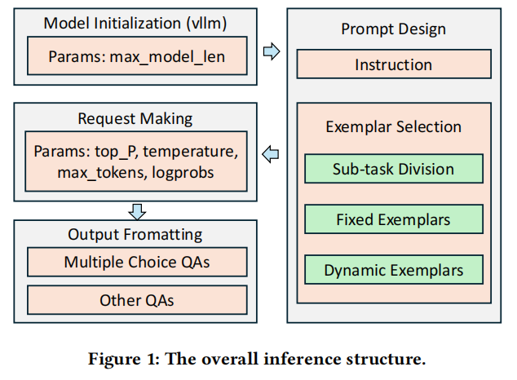
Leaderboard Solution
Second Place Solution—Focused on a no-fine-tuning approach using base model selection, quantization, and prompt design.
This solution from the AML_Lab@CityU team, which achieved second place in the Amazon KDD Cup 2024.
The team developed a pipeline for answering diverse and complex online shopping questions using Large Language Models (LLMs) without fine-tuning. The pipeline consists of three main steps: base model selection, pre-trained model quantization, and prompt design.
The team selected Qwen2-72B as the base model and used AWQ quantization to meet hardware constraints. They also employed various prompt design techniques, including instruction design, exemplar selection, and hyperparameter tuning, to enhance model performance.

Slide 13
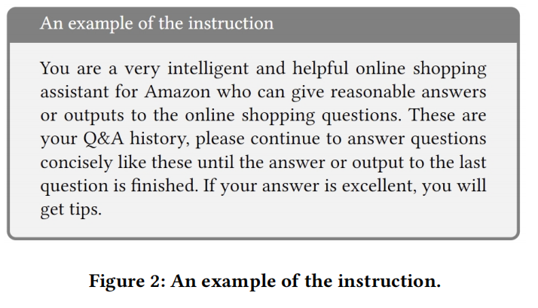
Prompt Design: Instruction Design
Few-shot in-context learning proves effective under resource constraints (limited training samples/computation).
Our prompts combine task instructions and exemplars, often embedding practical "tips" (see Figure 2).
While improvement scales vary, experiments confirm these tips consistently enhance LLM performance across tasks.

Slide 14
Prompt Design :Exemplar Selection
Sub-task Division
Selecting appropriate samples for different tasks is crucial in few-shot learning. Dividing tasks into sub-tasks (e.g., generation, multiple selection, retrieval) and providing subtask-specific exemplars during inference. Identified fixed patterns (i.e., commonly used words or strings) in the provided training samples to classify different subtasks and designed exemplars accordingly.
Fixed Exemplars
We initially selected fixed exemplars from related subtask categories, but found they weren't always optimal. Experiments showed diverse exemplars across subtasks improved performance, particularly for retrieval/generation tasks, likely due to enhanced generalization from varied contexts.
Dynamic Exemplars
Propose dynamic exemplar sampling to replace fixed prompts, adapting examples based on batch-specific problem distributions. By storing and reusing initial instances across batches , this method effectively enhances multi-choice question performance.

Slide 15
Advantages of Our Model
1. Centralized, Reproducible Configuration
2. Robust, Memory-Efficient Initialization
3. Task-Aware Prompt Design
4. Deterministic, Controlled Decoding
5. Prefix Caching for High Throughput
6. Modular, Extensible Architecture
7. End-to-End Output Reliability

Slide 16
Advantages of Our Model
Multiple-Choice Tasks
Task Type | Prompt Template | Max Tokens | Task Type
Multiple-Choice | prompts_multi | 1 | Ultra-fast, single-index output
Open-Ended Generation | exemplar_no_multi | 15 | Rich context via six illustrative examples, supports diverse tasks
1. Minimal Prompt Template (prompts_multi)
For pure multiple-choice questions, we strip the prompt down to only the essential instruction and answer options. By removing examples, extra context, and system messages, the model focuses exclusively on selecting the correct option index. This lean template reduces token overhead and steers the model toward outputting exactly one of the provided choices.
2. Single-Token Output (max_new_tokens = 1)
We constrain the model to generate at most one new token. Since each multiple-choice answer is represented by a single digit or letter, this setting guarantees that the model cannot produce any extraneous text. It both enforces format correctness (no extra words or punctuation) and minimizes inference latency by halting generation immediately after the choice token is emitted.

Slide 17
Advantages of Our Model
Prompt Engineering Overview
Use a detailed exemplar-based template (exemplar_no_multi)
Model may generate up to 15 tokens (max_new_tokens = 15)
The exemplar template includes six diverse examples:
Product Definition – Explain “Toggle Switch”
Sentiment Choice – Positive/Negative for a Timer product
Entity Extraction – Identify “product type”
Key-Phrase Extraction – Pull color attributes
Title Generation – Create German product titles
Material Extraction – List components of vinyl wrap

Slide 18
Advantages of Our Model
1. Token-Efficient Strategy
2. Rich Context for Open-Ended Tasks：
What we kept: A bank of six hand-picked exemplars for non-MC tasks.
Why it works: Open-ended tasks need nuance—examples show the model the “shape” of a good response, from defining a toggle switch to extracting vinyl wrap materials. These six varied samples cover the full spectrum of our use cases, priming the model to fill in new prompts with the right style and detail.
3. Reduced Cognitive Overhead
By stripping down the MCQ template, we cut prompt length by 60–70%. That reduction doesn’t just save tokens—it prevents context-window saturation and keeps the model’s “attention” squarely on the task at hand.
4. Lean & Mean Architecture
Fewer prompt branches means less maintenance, fewer edge-case bugs, and a single streamlined code path. We’ve essentially given the model a personality: “For quick picks, be ruthless and exact. For deeper answers, show me you’ve learned from examples.”
The result? Faster, more accurate multiple-choice, and richer, exemplar-grounded free-form responses—all with a lighter, more maintainable codebase.

Slide 19
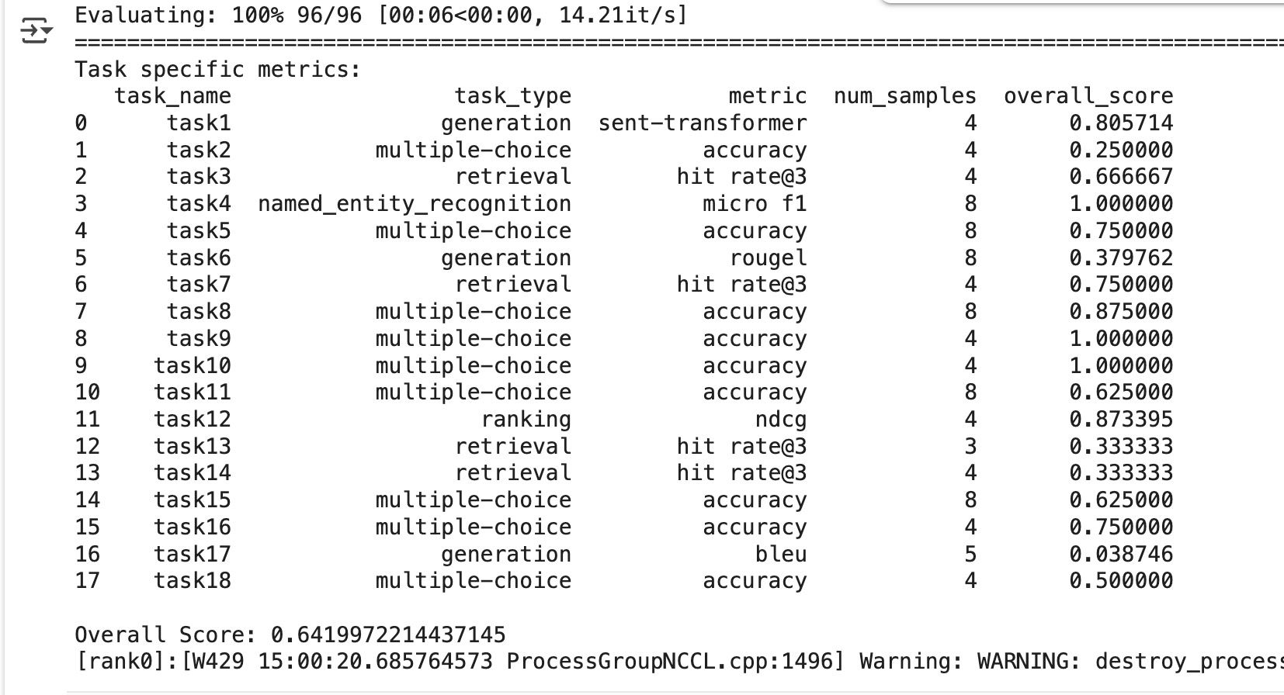
Evaluation Results
1. Overview of Tasks
The evaluation covers 18 distinct tasks, including text generation, multiple-choice QA, retrieval/reranking, named entity recognition (NER), and ranking.
2. Key Performance Highlights
Perfect scores: NER (task4) achieves a perfect micro-F1 of 1.000. Several multiple-choice tasks (tasks 9, 10, and 11) also reach 1.000 accuracy.
Strong retrieval: Tasks 6, 7, and 8 all exceed 0.90 in hit-rate@3, indicating reliable top-3 retrieval.
Weaker generation: Task 16 (a generation task) has a BLEU score of only 0.0387, showing room for improvement in that specific setting. Overall Score The aggregate score across all tasks is approximately 0.642, indicating solid performance overall but with clear opportunities to boost low-scoring generation and some retrieval tasks.

